Slide 1
Project Fly
Deepak Adhikari (68018)
Kshitiz Tiwari (68035)

Slide 2
Problem statement
Although Bluetooth is simple to use, it has disadvantage of slower file transfer rate
Access Point, AdHoc still complex
Access Point is not available everywhere
Hotspot and AdHoc is still difficult to configure for normal users
Lacking application that delivers simplicity of bluetooth and performance of WiFi

Slide 3
Introduction
Newer approach to share files between laptops
Simplicity of bluetooth
Performance of Wi-fi

Slide 4
Objectives
To make file transfer between laptops simpler
To develop an application that gives intuitive user experience to share file
To make user friendly environment for establishing connection between laptops

Slide 5
Features
Easily establish connection between two laptops
Easily share files between laptops
Application has both GUI and CUI
Seamlessly works across GUI and CUI

Slide 6
Methodology
Could not follow product oriented software development
Classified our work into four phase
Socket study / implementation
Study of Wi-Fi Direct
Implementation of Wi-Fi Direct
Integration of Wi-Fi direct and Socket

Slide 7
System Design

Slide 8
Program Flow

Slide 9
Sending file

Slide 10
Receiving file

Slide 11
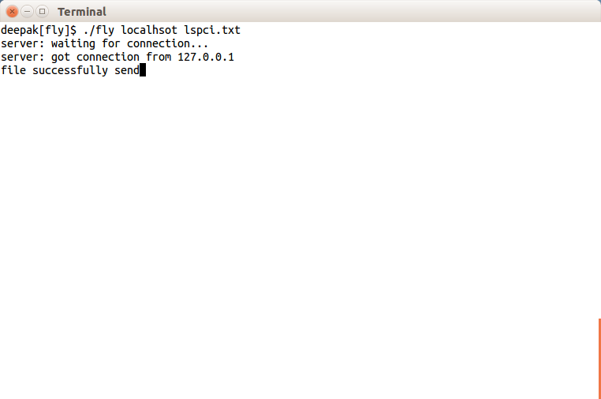
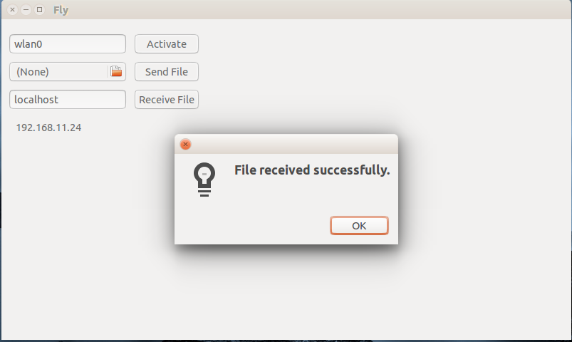
Output
Fly CUI
Fly GUI

Slide 12

Demo: CUI
Receiving File
Sending File

Slide 13
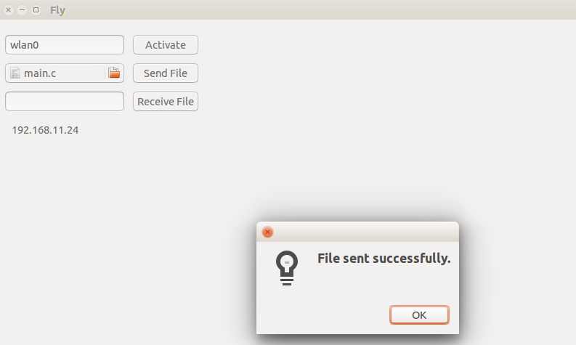
Demo: GUI
Sending file
Receiving file

Slide 14
Requirements
Hardware
Wi Fi Direct certified hardware for Group Owner
Legacy Wifi or Wifi certified for clients
Software
Machine running Linux alike OS
WPA supplicant

Slide 15
Limitations
The application only works on Linux alike system
IP needs to be assigned manually
Character files can only be transferred

Slide 16
Future enhancements
Implementation of DHCP
Support across all Operating System
Transfer of file with any file format
Establish Wifi Direct connection from fly

Slide 17
Conclusion
Wifi direct delivers simplicity of Bluetooth and at the same time Bandwidth performance of Wifi
Although OEM ships with Wifi Direct certification, connecting and sharing contents across different OEM is still difficult
Wifi is new and emerging technology. It will take some time to commonly use across all devices and become standard

Slide 18
Thank! You

Slide 19
Any Questions?

